Slide 1
Type of attack

Slide 2
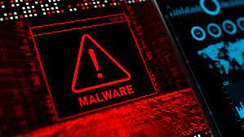
Malware
Malware:
Malicious software refers to any type of software specifically designed to damage, or gain unauthorized access to computer systems, networks.
it can be used for a variety of purposes, from stealing personal or business information to demanding ransom in exchange for access to locked files.

Slide 3
Real-World Example
Real-World Example: Malware as a Disease in the Human Body
Scenario:
Imagine you are in a classroom, and one of your friends catches the flu. At first, they seem fine, but after a day or two, they start coughing and sneezing. Soon, other students sitting near them also start getting sick, and within a few days, half the class is infected.

Slide 4
How This Relates to Malware?
Just like the flu spreads from one person to another, malware spreads from one computer to another.
Flu Virus = Computer Virus Just like the flu infects a person’s body, a computer virus infects a computer by attaching itself to files or programs.
Sneezing & Coughing = Spreading Malware If an infected student sneezes, others nearby breathe in the germs and get sick. Similarly, if you open an infected email attachment or click on a malicious link, your computer gets infected and can spread the malware to others.

Slide 5
Malware
Weak Immune System = Unprotected Computer If someone has a weak immune system (not eating well, not getting enough sleep), they are more likely to get sick. Likewise, if a computer doesn’t have antivirus software or is not updated, it is more likely to be infected by malware.
Vaccination = Antivirus Software Getting a flu shot (vaccine) helps protect against the flu. Similarly, installing antivirus software helps protect your computer from malware.

Slide 6

Type of Malware
Virus: virus is a computer programme that attaches itself to another legal program and causes damages to the computer system or to the network and often require user interaction to spread.

Slide 7
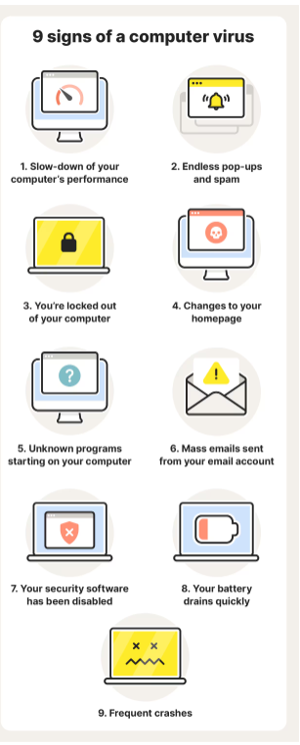
Virus symptoms
Prevention can be by Install and regularly update antivirus software on your device.

Slide 8

Type of Malware
Worm: Worms are self-replicating malware that can spread independently across computer networks, typically without user interaction. They can consume network bandwidth and cause widespread damage.
Prevention can be by disable any unused services and ports on your device.

Slide 9

Type of Malware
Trojan Horse: appears as a legal program or file but contains hidden malicious code. When executed, it can perform various malicious actions, such as stealing data, providing remote access to an attacker, or damaging the system.
Prevention can be by Keep your operating system and software up to date

Slide 10
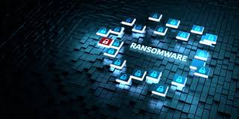
Type of Malware
Ransomware: Ransomware is a type of malware that encrypts a user's files or locks them out of their system, demanding a ransom payment in exchange for the decryption key or access to the system.
Prevention can be by avoid click on unsafe links in spam messages or on unknown websites

Slide 11
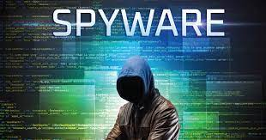
Type of Malware
Spyware: Spyware is designed to gather information about a user or their activities without their knowledge or consent. It can capture keystrokes, record screen activity, or monitor web browsing.
Prevention can be by avoid email links and attachments when possible.

Slide 12

Phishing
Phishing: Phishing attacks are social engineering attacks that trick users into giving away sensitive information or downloading malware. These attacks often come in the form of emails or text messages or voice call.
Prevention can be by avoiding clicking links, never giving sensitive information via phone not replay an unsecured text messages.

Slide 13
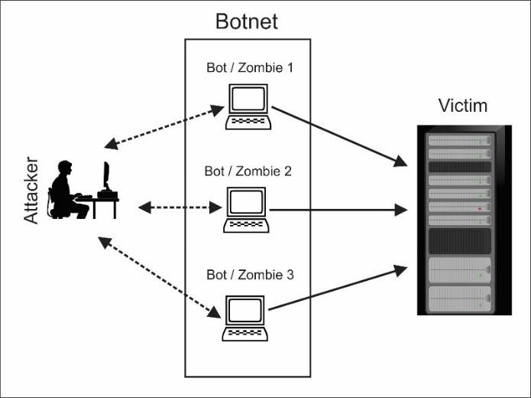
Botnet
Botnet: is like an army of robots on the internet. These "robots" are actually compromised computers controlled by a single person or group. They can be used to do things like sending lots of spam emails, launching cyberattacks on websites, or stealing information.

Slide 14
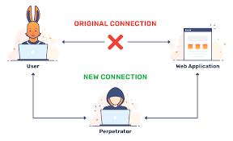
Man-in-the-middle attacks
Man-in-the-middle attacks: In MitM attacks, an attacker intercepts communications between two parties, allowing them to eavesdrop or even modify the communication.
Prevention can be by using a VPN (virtual private network) when connecting online

Slide 15
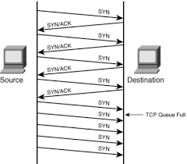
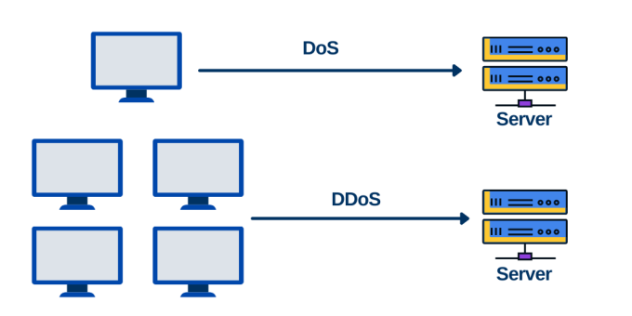
Denial of Service (DoS) Attacks
Denial of Service (DoS) Attacks: In a DoS attack, the attacker floods a service with a massive volume of traffic, overwhelming its resources and causing it to become unavailable to legitimate users. Distributed Denial of Service (DDoS) attacks involve multiple compromised devices (a botnet) working in concert to launch the attack.

Slide 16
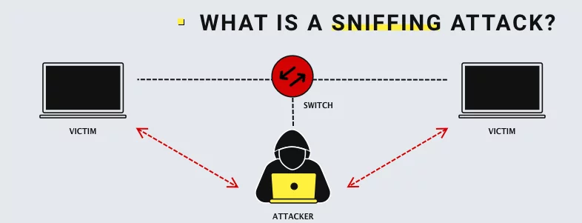
Packet Sniffing
Packet Sniffing: Packet sniffing involves capturing and analysing network traffic to intercept sensitive information, such as login credentials, credit card numbers, or other confidential data being transmitted over the network.

Slide 17
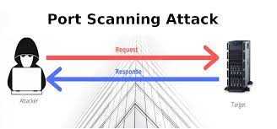
Port Scanning
Port Scanning: Attackers use port scanning tools to identify open ports on a target system. Knowing which ports are open can help attackers identify potential vulnerabilities that they can exploit.

Slide 18
DNS Spoofing
DNS Spoofing : Attackers can manipulate the Domain Name System (DNS) to redirect users to malicious websites or intercept their communications. This can lead to the compromise of sensitive information.
Utilize a Virtual Private Network (VPN) to encrypt your internet traffic,

Slide 19
ARP Spoofing
ARP Spoofing: In ARP spoofing attacks, attackers manipulate the Address Resolution Protocol (ARP) to associate their MAC address with the IP address of a legitimate device on the network. This allows them to intercept and modify network traffic.
Prevention can be by Implementing packet-filtering firewalls can help protect against ARP spoofing by flagging data packets from unauthorized sources and blocking them

Slide 20
Brute force attack
Brute force attack: it is a type of cyberattack in which an attacker tries to gain unauthorized access to a system by systematically trying every possible combination of usernames, passwords until the correct one is found.
Prevention can be by Using complex, long, and unique passwords makes it significantly more difficult for attackers to guess the correct combination.

Slide 21

Type of attack

Slide 22
Activity
Use the internet, news, and academic sources to research cyber security in the Internet of Things.
Complete the following tasks:
Task 1: Find out information about any recent cyber attacks in the news or online? If so, could you describe what you know about them?
Task 2: How do you think these recent cyber attacks might impact the affected organizations and individuals?

Slide 23
What’s next on the agenda?
Break: 20 minutes
Lab Explanation
Lab Work

Slide 24


